Slide 1

Cab Booking system
Using SQL

Slide 2
OBjective
To design and implement a robust cab booking system using SQL, aimed at providing an efficient, scalable, and user-friendly platform for managing taxi services
Driver and Vehicle Management: Efficiently manage driver profiles, vehicle details, and availability.
User Management: Facilitate user registration, profile management, and booking history tracking.
Data Analytics and Reporting: Generate insightful reports on bookings, driver performance, and financial transactions for better decision-making.

Slide 3
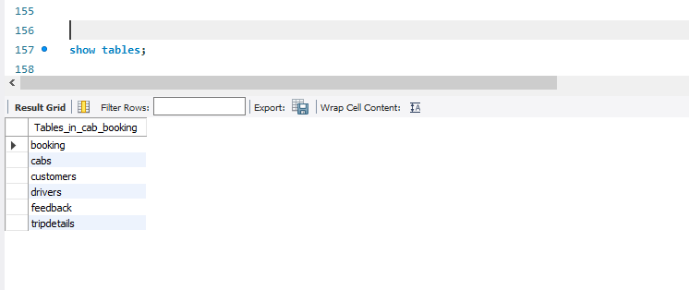
Write SQL statements to create all the tables with the specified columns.

Slide 4
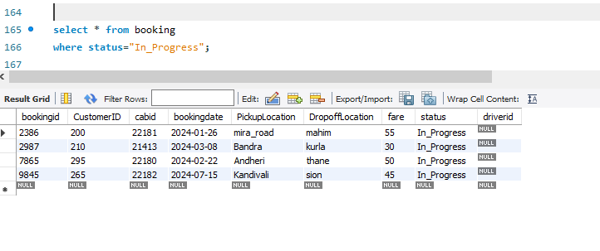
Write a query to select all bookings from the Bookings table where the Status is 'In Progress'.

Slide 5
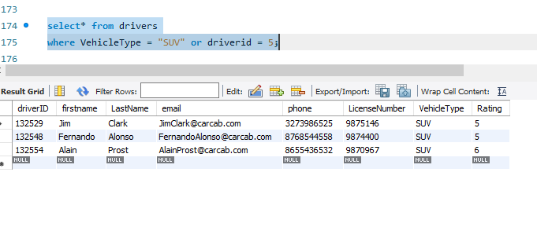
Write a query to select all cabs where the VehicleType is 'SUV' and the DriverID is 5

Slide 6
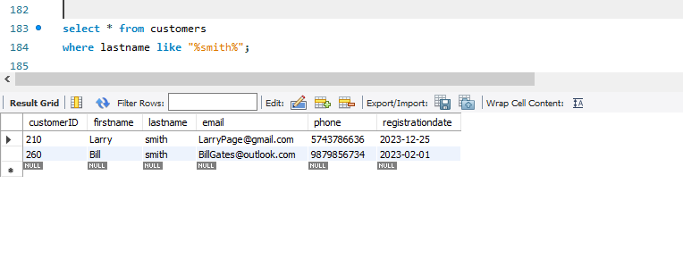
Write a query to select all customers whose LastName contains 'Smith'.

Slide 7
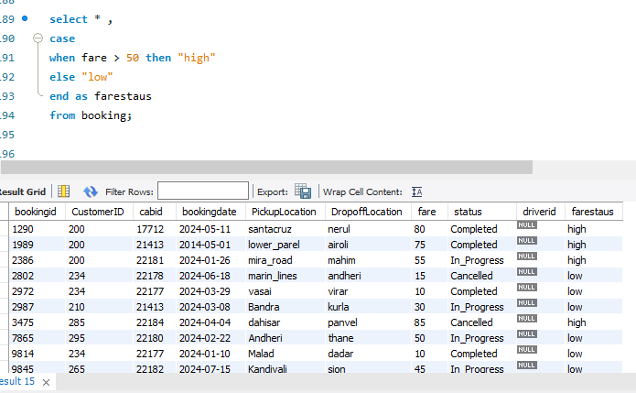
Write a query to select Fare from the Bookings table and a new column FareStatus. If Fare is greater than $50, set FareStatus to 'High', otherwise 'Low'.

Slide 8
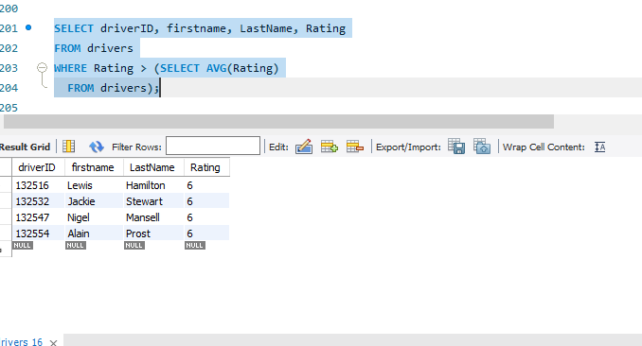
Write a query to find all drivers who have received a rating higher than the average rating of all drivers. Use a subquery in the WHERE clause to find these DriverIDs

Slide 9
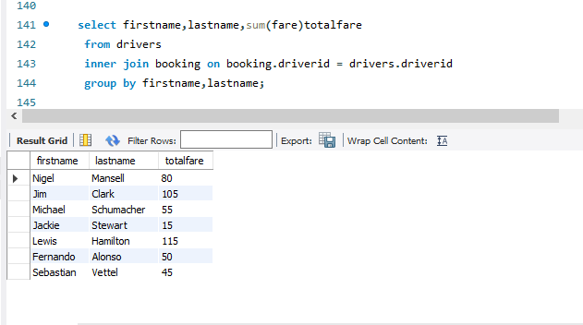
Write a query to get the total fare collected by each driver. Group by driver Name

Slide 10
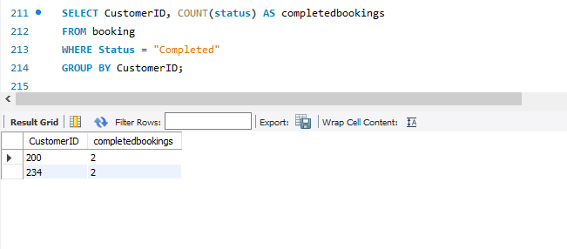
Write a query to get the total number of completed bookings for each customer, but only include customers with more than 2 completed bookings.

Slide 11
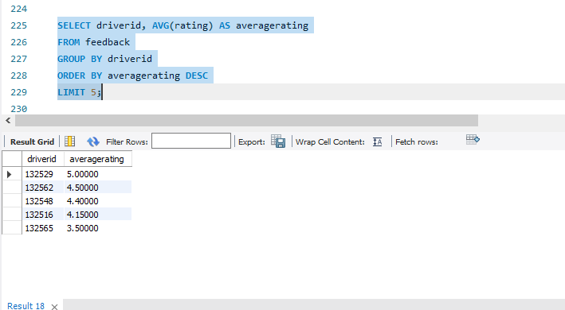
Write a query to select the top 5 drivers with the highest average ratings.

Slide 12
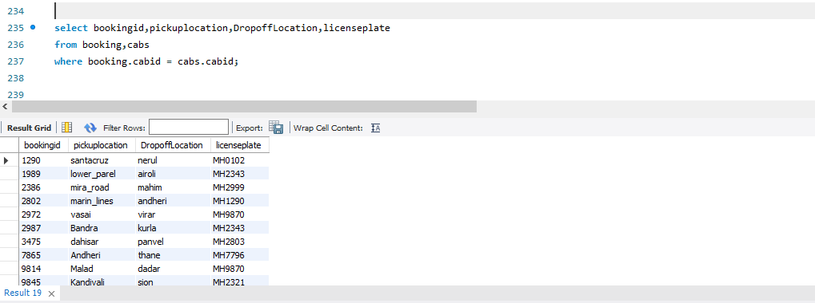
Write a query to join Bookings with Cabs to get a list of all bookings with PickupLocation, DropoffLocation, and LicensePlate.

Slide 13
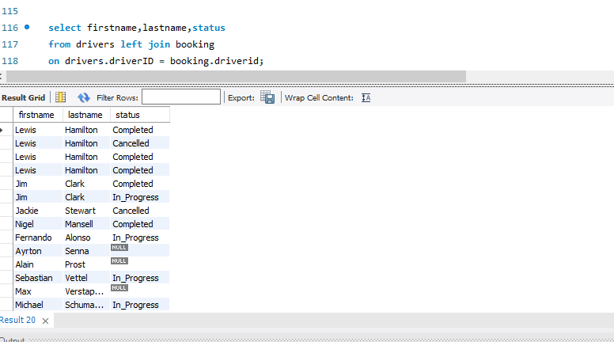
Write a query to get a list of all drivers and any associated bookings. Include drivers who might not have any bookings.

Slide 14
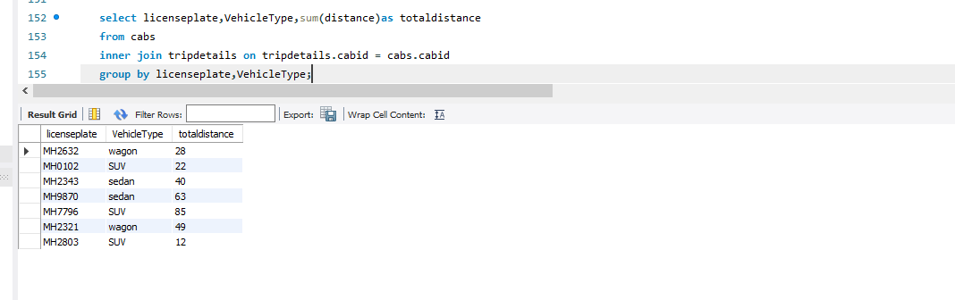
Write a query to get the total distance covered for each cab. Use an INNER JOIN between Cabs and TripDetails, and group by CabID.

Slide 15
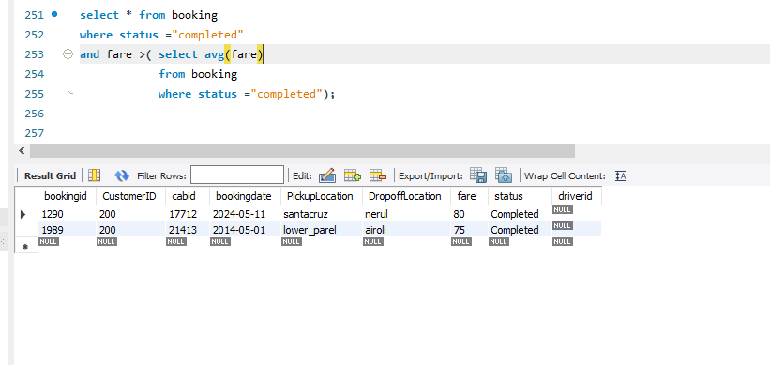
Write a query to find all bookings where the fare is higher than the average fare for all completed bookings. Use a subquery in the WHERE clause to find these BookingIDs.

Slide 16
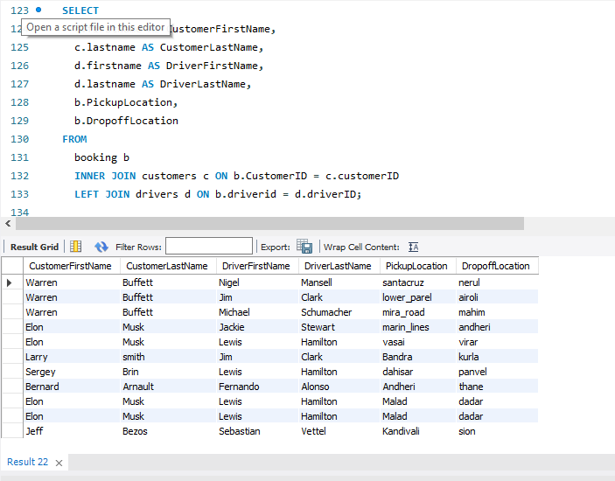
Write a query to list FirstName and LastName of customers, FirstName and LastName of drivers, PickupLocation, and DropoffLocation for all bookings. Use INNER JOIN and LEFT JOIN as necessary to get all required details.

